Slide 1
Ensemble learning
By
Dr. S PADMANABHAN

Slide 2
What is Ensemble learning in Machine Learning?
Ensemble learning is one of the most powerful machine learning techniques that use the combined output of two or more models/weak learners and solve a particular computational intelligence problem.
E.g., a Random Forest algorithm is an ensemble of various decision trees combined.
Ensemble learning is primarily used to improve the model performance, such as classification, prediction, function approximation, etc. In simple words, we can summarize the ensemble learning as follows:

Slide 3
"An ensembled model is a machine learning model that combines the predictions from two or more models.”
The basic idea behind ensemble learning is that by leveraging the strengths of different models, it is possible to create a more robust and accurate model than any single model alone.
Ensemble methods are widely used in both classification and regression tasks, and they are known for their ability to enhance the accuracy, generalization, and stability of machine learning models.

Slide 4
Why Ensemble Learning?
Reduction in Overfitting: Individual models can be prone to overfitting, especially complex models. By averaging or combining multiple models, the ensemble can reduce the likelihood of overfitting.
Improved Accuracy: Ensembles can achieve higher accuracy and better predictive performance than single models.
Reduction in Bias and Variance: By combining different models, ensembles can balance the trade-offs between bias (error due to overly simplistic models) and variance (error due to overly complex models).
Robustness: Combining models can make the predictions more robust against noise or fluctuations in the data.

Slide 5
Types of Ensemble Learning Methods
There are 3 most common ensemble learning methods in machine learning. These are as follows:
Bagging
Boosting
Stacking

Slide 6
1. Bagging (Bootstrap Aggregating)
Bagging is a method of ensemble modeling, which is primarily used to solve supervised machine learning problems. It is generally completed in two steps as follows:
Bootstrapping: It is a random sampling method that is used to derive samples from the data using the replacement procedure. In this method, first, random data samples are fed to the primary model, and then a base learning algorithm is run on the samples to complete the learning process.
Aggregation: This is a step that involves the process of combining the output of all base models and, based on their output, predicting an aggregate result with greater accuracy and reduced variance.

Slide 7
1. Bagging (Bootstrap Aggregating)
Example: Random Forests are a popular example of bagging, where multiple decision trees are trained on different subsets of the data. Each tree's output is averaged or voted upon to get the final prediction.
Advantages: Bagging helps reduce variance and prevents overfitting, particularly for high-variance models like decision trees.
Applications: Random Forests are widely used for tasks such as image classification, fraud detection, and credit scoring.

Slide 8
2. Boosting:
Boosting is an ensemble method that enables each member to learn from the preceding member's mistakes and make better predictions for the future. Unlike the bagging method, in boosting, all base learners (weak) are arranged in a sequential format so that they can learn from the mistakes of their preceding learner.
Hence, in this way, all weak learners get turned into strong learners and make a better predictive model with significantly improved performance.

Slide 9
2. Boosting:
Examples:
AdaBoost (Adaptive Boosting): It assigns weights to training instances, adjusting them as more models are added to focus on the difficult cases.
Advantages: Boosting methods can achieve high accuracy and are often used in winning solutions for machine learning competitions.
Applications: Gradient boosting is commonly used for ranking problems (like search engine result ranking), customer churn prediction, and sales forecasting.

Slide 10
3. Stacking
Stacking is one of the popular ensemble modeling techniques in machine learning. Various weak learners are ensembled in a parallel manner in such a way that by combining them with Meta learners, we can predict better predictions for the future.
This ensemble technique works by applying input of combined multiple weak learners' predictions and Meta learners so that a better output prediction model can be achieved.

Slide 11
3. Stacking
In stacking, an algorithm takes the outputs of sub-models as input and attempts to learn how to best combine the input predictions to make a better output prediction.
Stacking is also known as a stacked generalization and is an extended form of the Model Averaging Ensemble technique in which all sub-models equally participate as per their performance weights and build a new model with better predictions. This new model is stacked up on top of the others; this is the reason why it is named stacking.

Slide 12
Architecture of Stacking
The architecture of the stacking model is designed in such as way that it consists of two or more base/learner's models and a meta-model that combines the predictions of the base models. These base models are called level 0 models, and the meta-model is known as the level 1 model. So, the Stacking ensemble method includes original (training) data, primary level models, primary level prediction, secondary level model, and final prediction. The basic architecture of stacking can be represented as shown below the image.

Slide 13
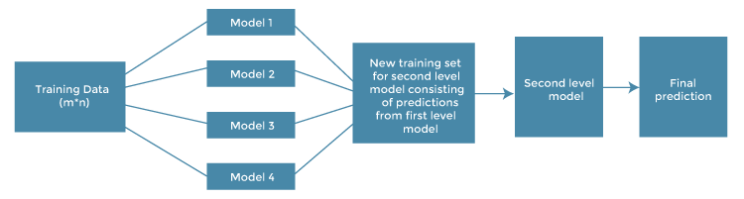
Architecture of Stacking

Slide 14
Original data: This data is divided into n-folds and is also considered test data or training data.
Base models: These models are also referred to as level-0 models. These models use training data and provide compiled predictions (level-0) as an output.
Level-0 Predictions: Each base model is triggered on some training data and provides different predictions, which are known as level-0 predictions.
Meta Model: The architecture of the stacking model consists of one meta-model, which helps to best combine the predictions of the base models. The meta-model is also known as the level-1 model.
Level-1 Prediction: The meta-model learns how to best combine the predictions of the base models and is trained on different predictions made by individual base models, i.e., data not used to train the base models are fed to the meta-model, predictions are made, and these predictions, along with the expected outputs, provide the input and output pairs of the training dataset used to fit the meta-model.

Slide 15
Steps to implement Stacking models:
There are some important steps to implementing stacking models in machine learning. These are as follows:
Split training data sets into n-folds using the RepeatedStratifiedKFold as this is the most common approach to preparing training datasets for meta-models.
Now the base model is fitted with the first fold, which is n-1, and it will make predictions for the nth folds.
The prediction made in the above step is added to the x1_train list.

Slide 16
Repeat steps 2 & 3 for remaining n-1 folds, so it will give x1_train array of size n,
Now, the model is trained on all the n parts, which will make predictions for the sample data.
Add this prediction to the y1_test list.
In the same way, we can find x2_train, y2_test, x3_train, and y3_test by using Model 2 and 3 for training, respectively, to get Level 2 predictions.
Now train the Meta model on level 1 prediction, where these predictions will be used as features for the model.
Finally, Meta learners can now be used to make a prediction on test data in the stacking model.

Slide 17
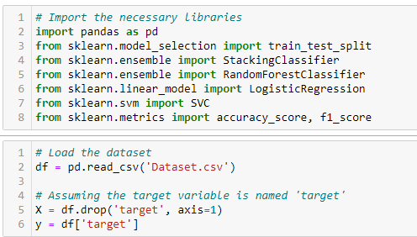
Stacking using the StackingClassifier from scikit-learn

Slide 18
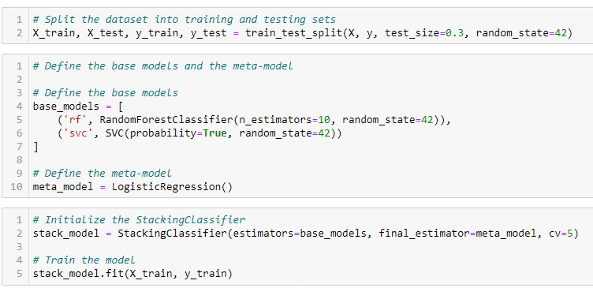

Slide 19
